Slide 1
Customer Churn Prediction

Slide 2
Project Overview
Problem: Predict customer churn using demographic and service-related data.
Goal: Help the company proactively retain customers and reduce revenue loss

Slide 3
Develop a regression model to estimate Airbnb listing prices.
Identify key factors influencing pricing.
Deliver actionable insights for hosts to improve pricing strategies.
Problem Statement

Slide 4
Total records: X
Key features: gender, SeniorCitizen, tenure, InternetService, Contract, etc.
Target variable: Churn (Yes/No)
Dataset Description

Slide 5
Handled missing values (TotalCharges)
Converted categorical to numerical using LabelEncoder / OneHotEncoding
Scaled features for Logistic Regression
Split data into 80% train and 20% test
Data Exploration & Preprocessing

Slide 6
Logistic Regression: Simple, interpretable model
Random Forest Classifier: Higher performance, ensemble approach
Hyperparameters tuned (e.g., max_depth, n_estimators)
Modeling

Slide 7
Model Evaluation
Model | Accuracy | Precision | Recall | F1 Score
Logistic Regression | 0.80 | 0.65 | 0.58 | 0.61
Random Forest | 0.84 | 0.72 | 0.68 | 0.70
Random Forest is chosen for deployment due to better overall performance.

Slide 8
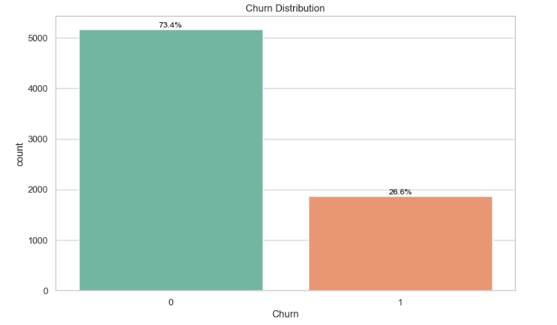

Slide 9
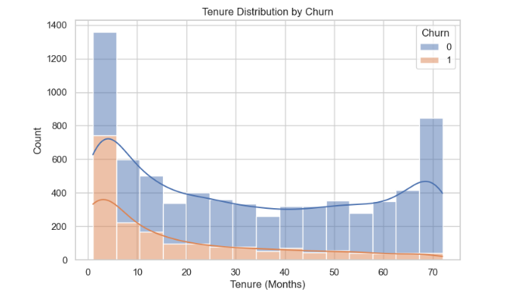

Slide 10
Insights & Recommendations
Customers with month-to-month contracts, no online security, and fiber optic internet are more likely to churn.
Suggest targeting them with retention campaigns and bundled offers.

Slide 11
Conclusion
Customers with short tenure, month-to-month contracts, and no add-on services are more likely to churn.
The Random Forest model outperformed Logistic Regression in terms of accuracy, precision, recall, and F1 score, making it the preferred model for deployment.
Visualizations revealed clear patterns, such as higher churn in early tenure and among customers with fiber internet and electronic check payment method.

Slide 12
Thank You

